Slide 1
ENSE 470, Milestone 7
Tiger Vikings
Uys Kriek
Jay Denesik
Samuel Iregbu
Christian Anwanaodung
April 11th, 2018

Slide 2
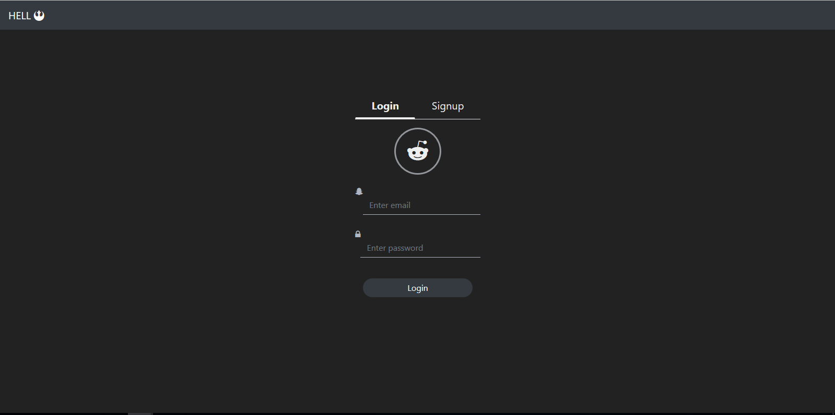
Introduction

Slide 3
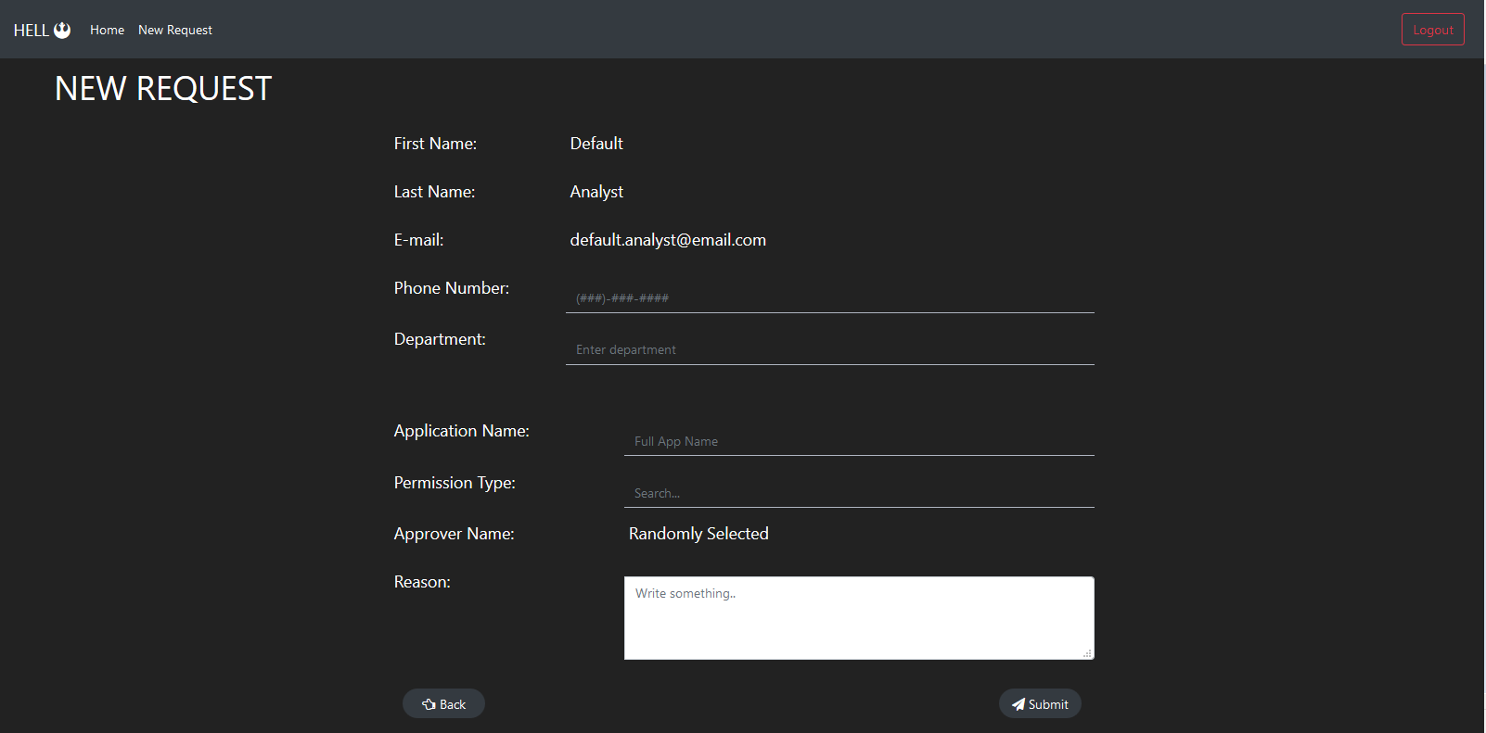
Introduction

Slide 4
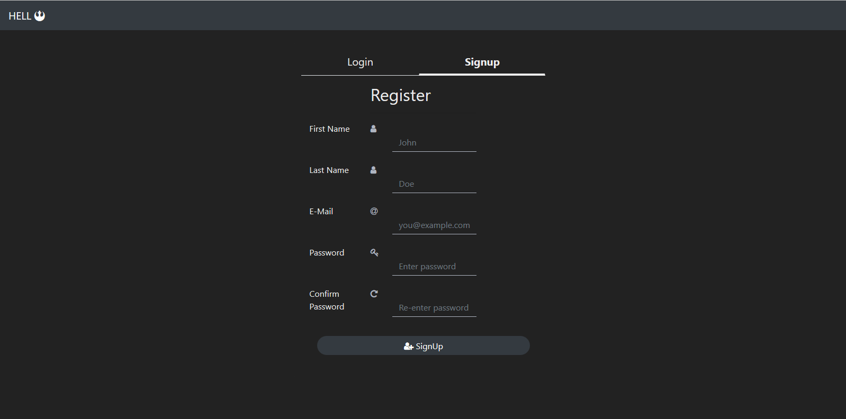
Introduction

Slide 5
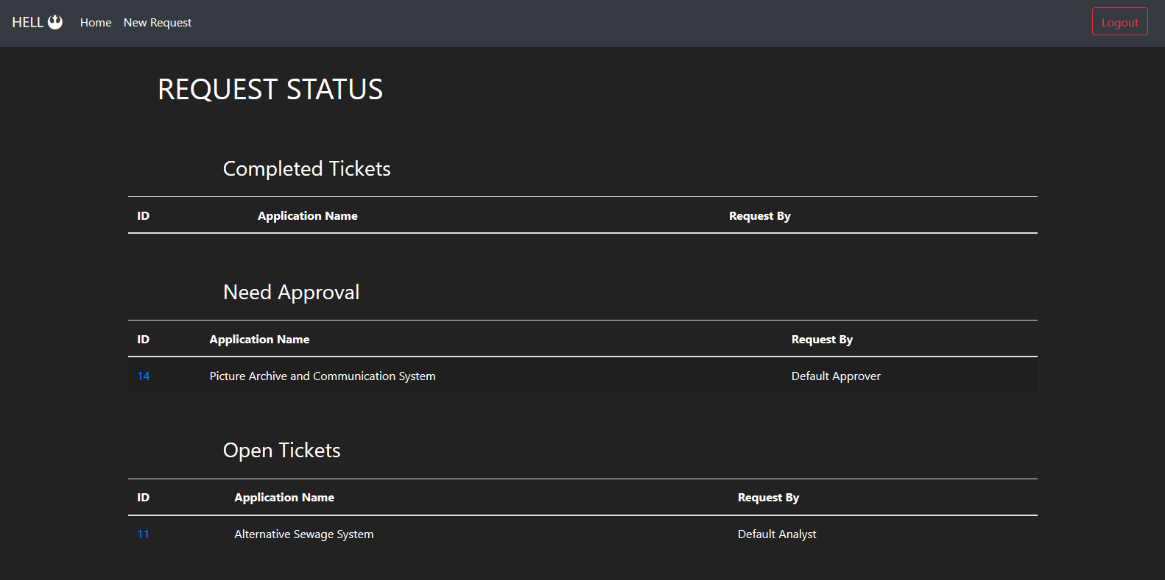
Introduction

Slide 6
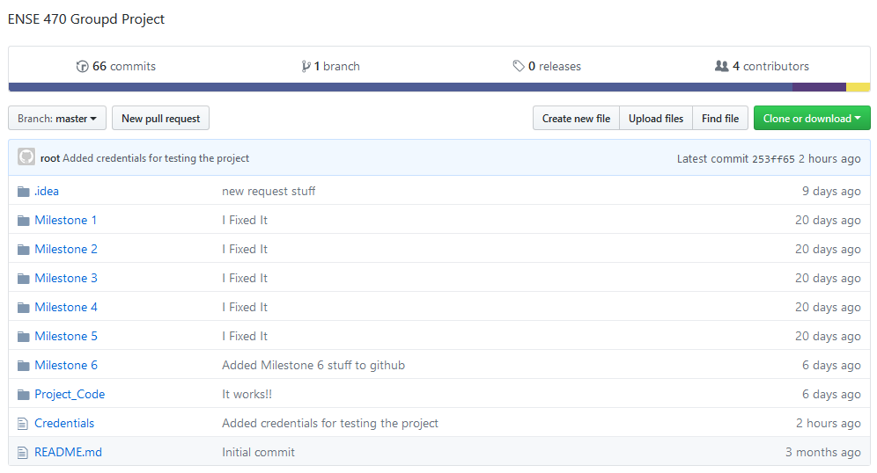
Team Github review

Slide 7
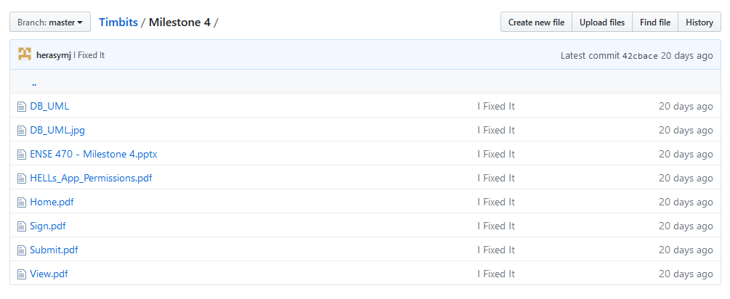
Team Github review

Slide 8
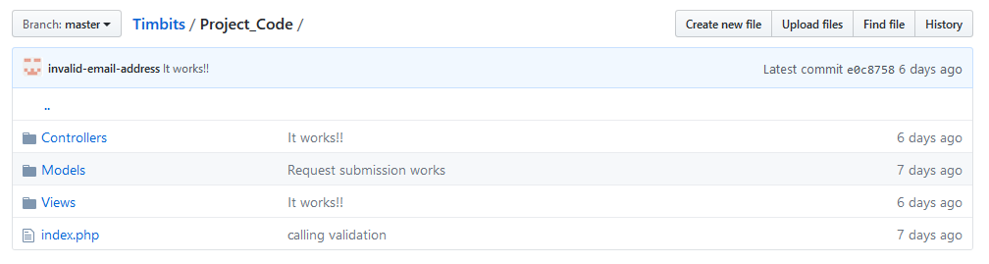
Team Github review

Slide 9
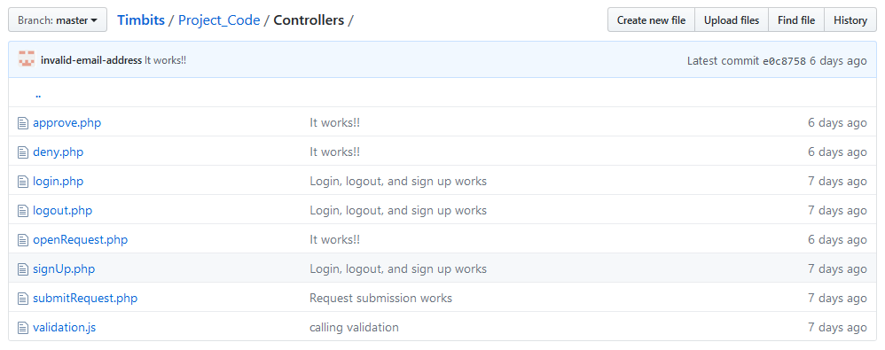
Team Github review

Slide 10

Team Github review

Slide 11
Refactor review
-Code is very readable
- Easy to follow
-Most of the ATDD’s passed
- Some error notification ATDD’s failed

Slide 12
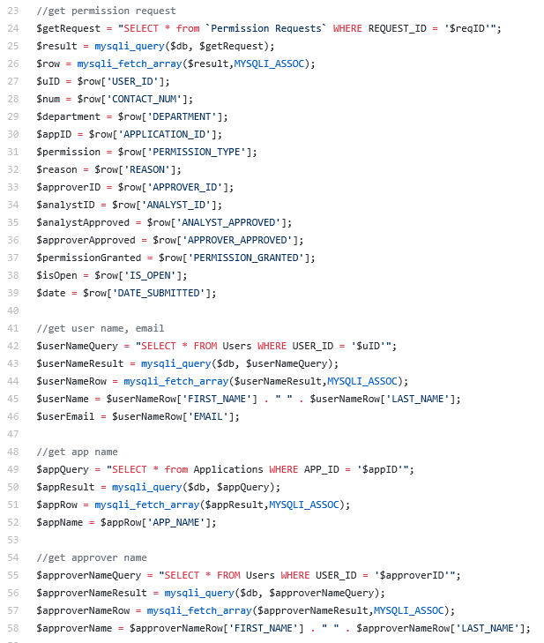
Refactor review
Code smells
Long method
-A method contains too many lines of code

Slide 13
Refactor review
Code smells
-Long Parameter List
- Too many parameters being passed into a method

Slide 14
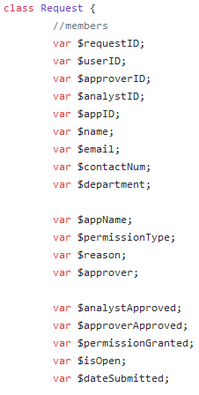
Refactor review
Code smells
-Data class
- Request class contains only fields and constructor
- Data is not operated on within the Request class

Slide 15
Design pattern discussion (High-level focus)
State design pattern
-Depending on which person you sign in as, defines what you can and cannot do
- IE. Approvers cannot request software, whereas users can

Slide 16
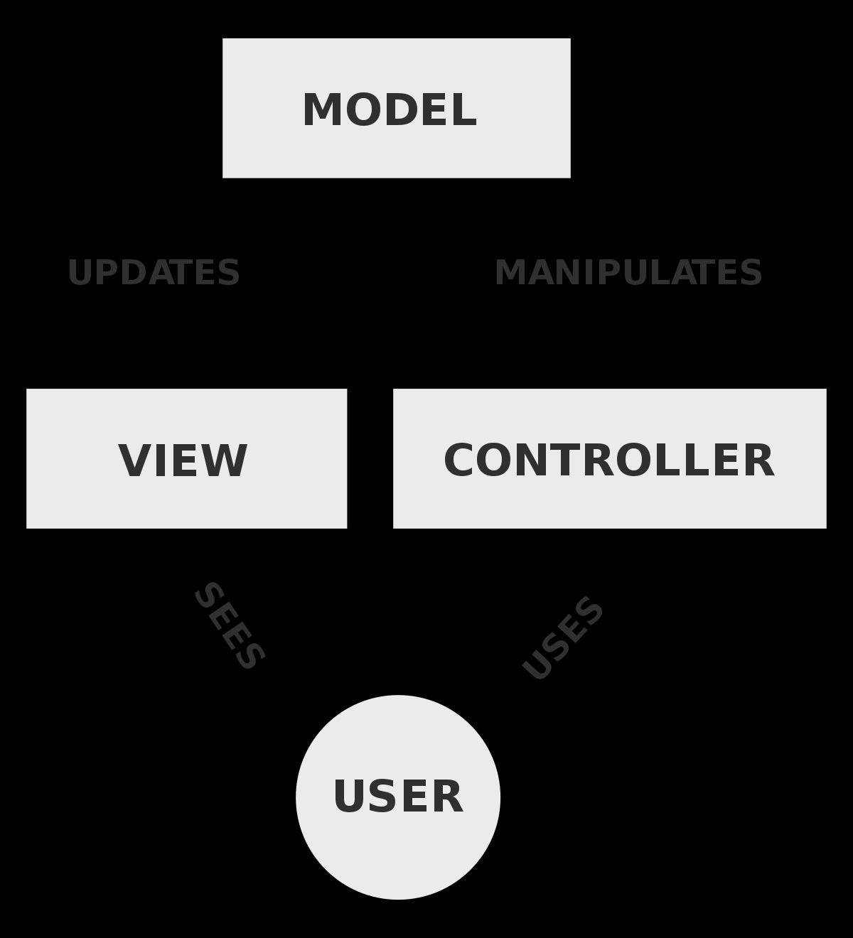
Design pattern discussion (High-level focus)
Main design pattern used was Model-View-Controller
-Appropriate for this project

Slide 17
Group reflection
How did you feel about this milestone? What did you like about it? What did you dislike?
-Understanding code could be difficult if not familiar with language
-What did you learn about yourself as you collaborated and worked through this milestone?
-We learned how to laugh and enjoy ourselves while working
-How will you use what you have learned going forward?
- Refactoring guru website was very useful. Taught us skills that will come in handy in our future careers
-What “stuff & things” related to this milestone would you want help with?
- Nothing it was good.

